Slide 1
Improving ResNet-based Feature Extractor for Face Recognition via Re-ranking and Approximate Nearest Neighbor Search
Presenter: Sheng-Hsing Hsiao
Advisor: Jyh-Shing Roger Jang
Dept. of CSIE, National Taiwan University, Taiwan
Notes:
透過重新排序與近似最鄰近搜尋以改進基於殘差網路之人臉特徵抽取器

Slide 2
Outline
Introduction
Related Work
Methods
Experiments
Conclusions and discussions
Notes:
不用多花時間講

Slide 3
Introduction
Face Recognition System
Barack Obama
Ma Ying-jeou
Compare two different face detectors on three benchmarks
Evaluate the performance of face verification
Present the re-ranking method and the suitable configuration for face identification on different datasets

Slide 4
Related Work
Face recognition
Triplet Loss:
VGGFace (2015)
Facenet (2015)
Angular/cosine-margin-based Loss
Large-Margin Softmax Loss : L-softmax loss (2016)
A-softmax loss (2017)
Notes:
Triplet-loss會很難收斂
L-softmax loss加大了原來softmax loss的學習難度。借用SVM的思想來理解的話，如果原來的softmax loss是只要支持向量和分類面的距離大於h就算分類效果比較好了，那麼L-softmax loss就是需要距離達到mh（m是正整數）才算分類效果比較好了。
A-softmax 則是進一步將vector投影到超球面上，可以學到超球面上角度的feature

Slide 5
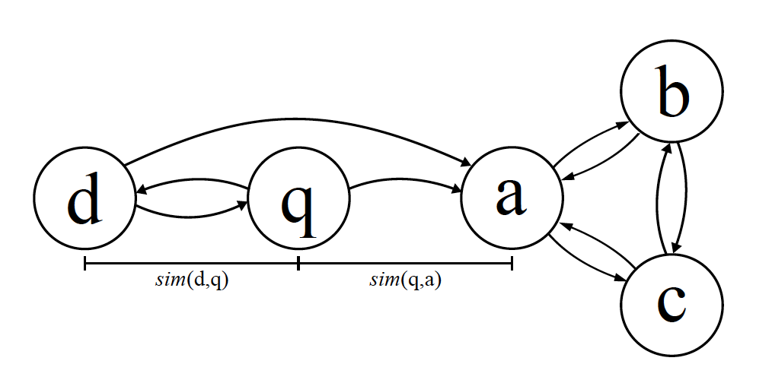
Related Work
Re-ranking for object retrieval
Hello neighbor: accurate object retrieval with k-reciprocal nearest neighbors (2011)
K-reciprocal nearest neighbors
Using different similarity measures for different parts allows for compensation of the “curse of dimensionality”.
Notes:
人臉辨識可以當作一個query的過程
如果我們的query是q
我們只看top2的nearest neighbor Q的鄰居就是d a但是q的reciprocal nearest neighbor只有d
因為d的nearest neighbor有q但是a的沒有q
可以理解為a可能是另外一群nodes而d則是比較接近q
從candidate的candidate也可以得到更多資訊確認這個candidate是不是跟query同一群的
我們的想法是從這個衍生，使用兩個不同的similarity measurements 可以降低維度災難的影響

Slide 6
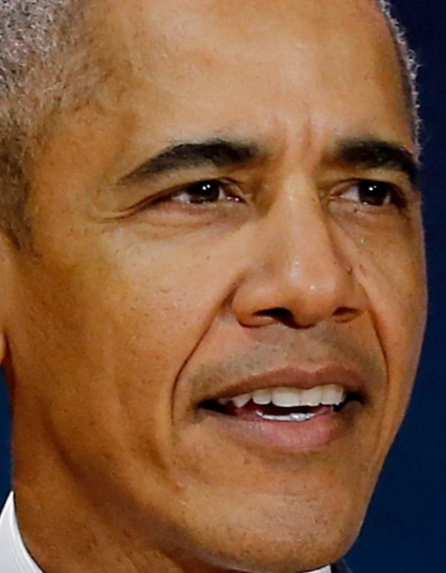
Method
System flowchart
Input image
Face
Detection
Face verification
Face
identification
Measure similarity
Face
Alignment
Face Feature Extractor
Re-ranking
Aligned face
Face representations
Below the
threshold
Barack Obama
Intruder
Notes:
再要做identification 前 這邊先定義兩個詞
With average without average

Slide 7
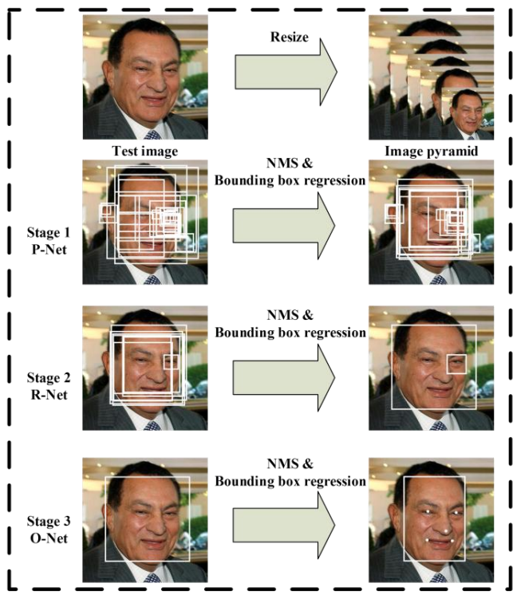
Method of Face Detection (1/2)
Face detection
MTCNN: Joint Face Detection and Alignment using Multi-task Cascaded Convolutional Networks (2016)
https://arxiv.org/abs/1604.02878
Notes:
在2016年提出的一個multi-task 論文的人臉偵測還有人臉特徵同時進行
給定一張照片的時候，將其縮放到不同尺度形成圖像金字塔，以達到尺度不變
總共有三個CNN cascade
3個stage對人臉的處理是按照一種由粗到細的方式
pnet是一個全卷積網絡(FCN)，用來產生candidate windows
Rnet是refine-net 進一步刪去錯誤的匡
Onet是output-net同時會產生五個臉上landmark

Slide 8
Method of Face Detection (2/2)
Face detection
Faceboxes: A CPU real-time face detector with high accuracy (2017)
https://arxiv.org/pdf/1708.05234
Back to flowchart
Notes:
2017
Rapidly Digested Convolutional Layers 主要是解決速度問題
快速的縮小feature map的大小
採用C.ReLU activation function
使用CRelU，減少卷積核數量可以保證輸出維度不變
Multiple Scale Convolutional Layers(MSCL)
Inception module 可以提供更多視野
類似於SSD，在不同的feature map進行檢測，可以找到不同size的人臉
作者提出來的點就在於增加小的anchor的訓練
定義了anchor 密度 來平衡對密度不足的anchor來增加偏移訓練

Slide 9
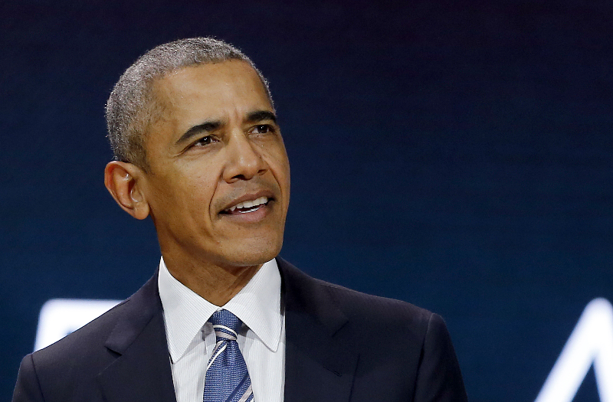


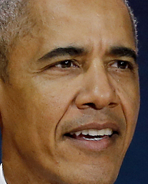
Method of Face Alignment
Dlib
V Kazemi, “One millisecond face alignment with an ensemble of regression trees.” (2014)
2D alignment to get the canonical view of a face
Back to flowchart
Notes:
旋轉過後會讓眼睛變在同儀條水平

Slide 10
Method of Face Feature Extractor
VGGFace2 (2018)
Dataset: VGGFace2 dataset
9131 celebrities, 8631 for training, 500 for test
3.31 million + faces, average 362 samples per-subject
Backbone: ResNet-50 (2016)
Convert the problem to N-ways classification problem and train on MS-Celeb-1M dataset
Remove the FC layer and get vectors, and then fine-tune on VGGFace2 as an 8631-classes classifier
Back to flowchart
Notes:
Parkhi, Omkar M., Andrea Vedaldi, and Andrew Zisserman. "Deep face recognition." bmvc. Vol. 1. No. 3. 2015.
先視為一個8631類的分類氣，
接著再把最後一層拿掉，變成face vector
還可以用triplet loss 來fine-tune

Slide 11
Method of Approximate Nearest Neighbor
Curse of Dimensionality (1998)
KNN do not generalize well in high dimension
ANN (Approximate Nearest Neighbor)
HNSW (Hierarchical Navigable Small World)
graph-based, without any need for additional search structures
https://arxiv.org/pdf/1603.09320
Back to flowchart
Notes:
Knn在高為的表現不好，因為有維度災難
因為knn完全對data不做處理, 在樣本數一樣的情況下，為度越高在空間的分佈越稀疏
越接近這個球的中心就越稀疏，當維度一直增加距離趨近於1
因為knn完全對data不做處理，如果樣本不夠多很容易overfitting
KNN就是要比n次, ann可以想像成對空間的劃分，可以找到子空間，不用所有的空間都找過，速度快但是犧牲一些準確
ＨＮＳＷ是一個greedy，先用粗略地找（邊比較大）達到局部最小的時候，再往下一層找，這層的邊都會比較小， 可以有效降低複雜度
https://www.zhihu.com/question/27836140 http://www.visiondummy.com/2014/04/curse-dimensionality-affect-classification/
self study - Curse of dimensionality: kNN classifier - Cross Validated
https://www.ryanligod.com/2018/11/27/2018-11-27%20HNSW%20%E4%BB%8B%E7%BB%8D/ https://stats.stackexchange.com/.../curse-of-dimensionality-knn-classifier

Slide 12
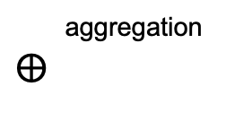
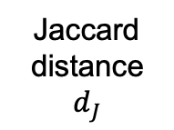
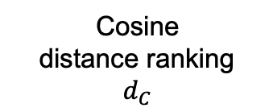
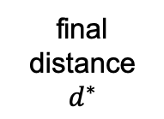
Method of Re-ranking
Re-ranking policy (without average)
Sample
Distance Measurement
Aggregation
Gallery
Cosine
distance ranking
$d_{C}$
Probe
aggregation
$$⨁$$
Jaccard
distance
$d_{J}$
final
distance
$d^{∗}$
Notes:
這邊的without average是指我這個probe image都要比較過每張圖
因為vector裡面都是大於0所以cosine distance=1-cos simility

Slide 13
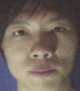
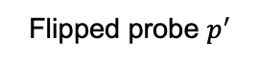
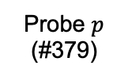
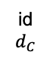
Method of Re-ranking
Re-ranking policy (without average)
id
$$d_{C}$$
#152_4
0.267590
#379_2
0.267723
#379_3
0.276431
#310_1
0.279959
#379_1
0.282797
Probe $p$
(#379)
Average the vectors
Flipped probe $p^{′}$
Notes:
Local query expansion 的一種
同一個人會share類似的feature
提供更多資訊

Slide 14
Method of Re-ranking
Re-ranking policy (without average)
id
$$d_{C}$$
#152_4
0.267590
#379_2
0.267723
#379_3
0.276431
#310_1
0.279959
#379_1
0.282797
Probe $p$
(#379)
Average the vectors
Flipped probe $p^{′}$

Slide 15
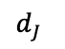
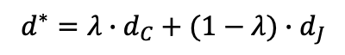
Method of Re-ranking
Re-ranking policy (without average)
id
$$d_{C}$$
#152_4
0.267590
#379_2
0.267723
#379_3
0.276431
#310_1
0.279959
#379_1
0.282797
Probe $p$
(#379)
Average the vectors
Flipped probe $p^{′}$
$$d^{∗}=λ∙d_{C}+(1−λ)∙d_{J}$$
$d_{J}$
1
0.4
0.4
0.8
0.6
Notes:
the local query expansion is very beneficial for further enhancing the performance
And the final distance is calculated as the weighted aggregation of the original distance and jaccard distance

Slide 16
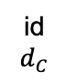
Method of Re-ranking
Re-ranking policy (with average)
Probe Image
(#314)
Flipped Probe Image
#020
0.187727
#314
0.185793
id
$$d_{C}$$
After
re-ranking
#314
0.189443
#020
0.189322
#314: 0.187618
#020: 0.188524
Notes:
with average/ without average

Slide 17
Experiments
Experimental settings
OS: Ubuntu 16.04
CPU: Intel(R) Xeon(R) E5-2630 10 cores @ 2.20GHz
GPU: GeForce GTX 1080 Ti
Memory: 128GB
Code language: Python 3.6.7

Slide 18
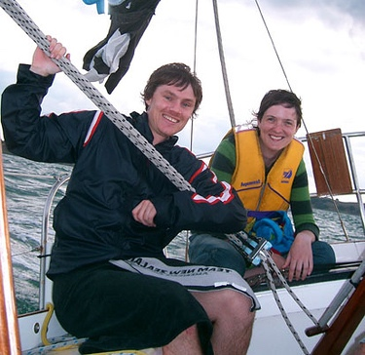
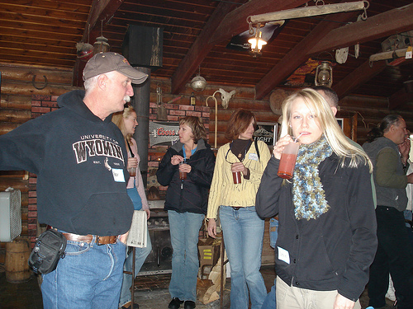
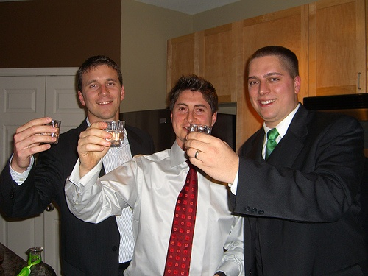
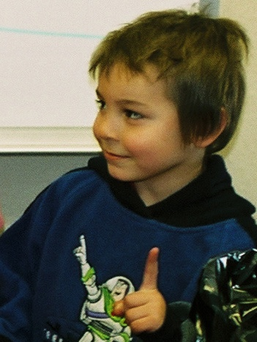
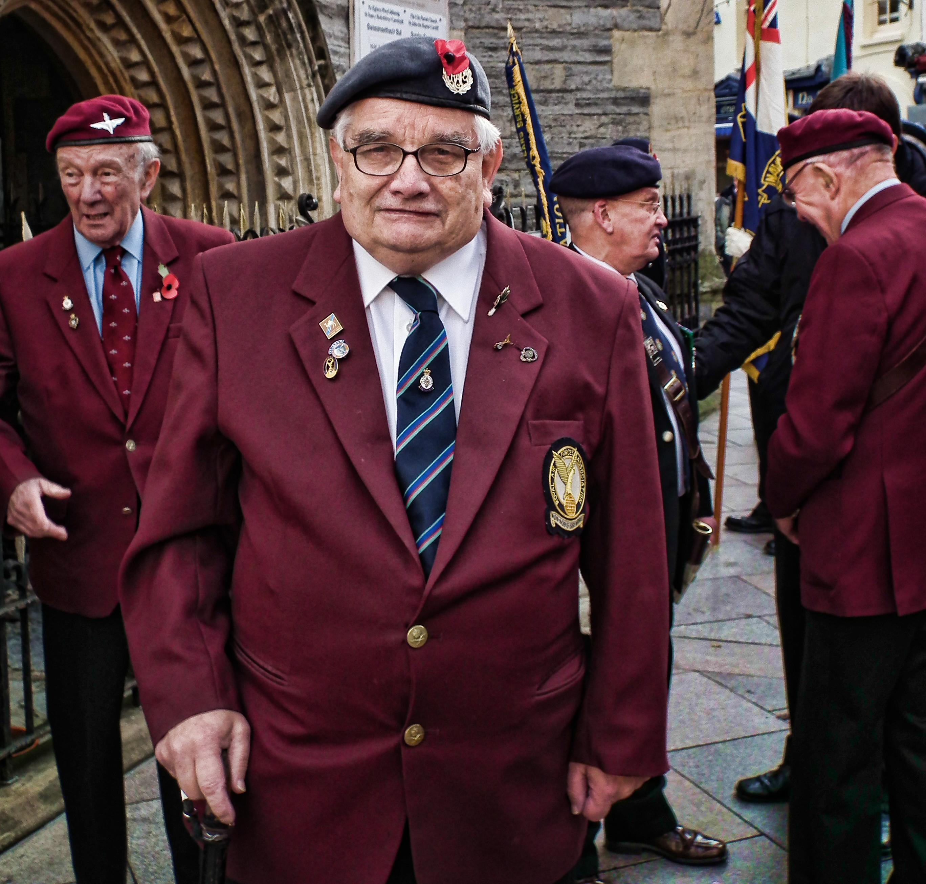
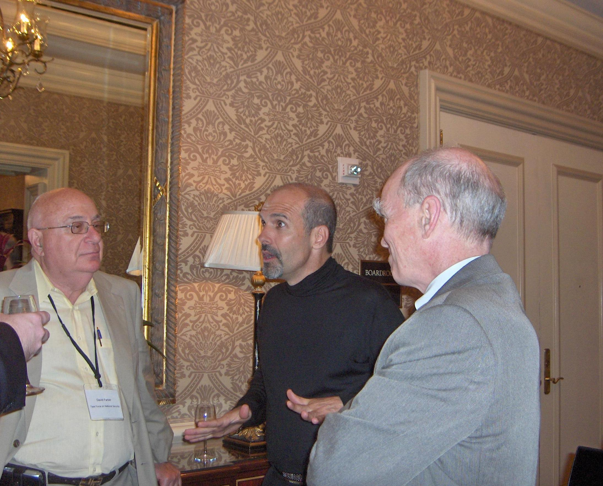
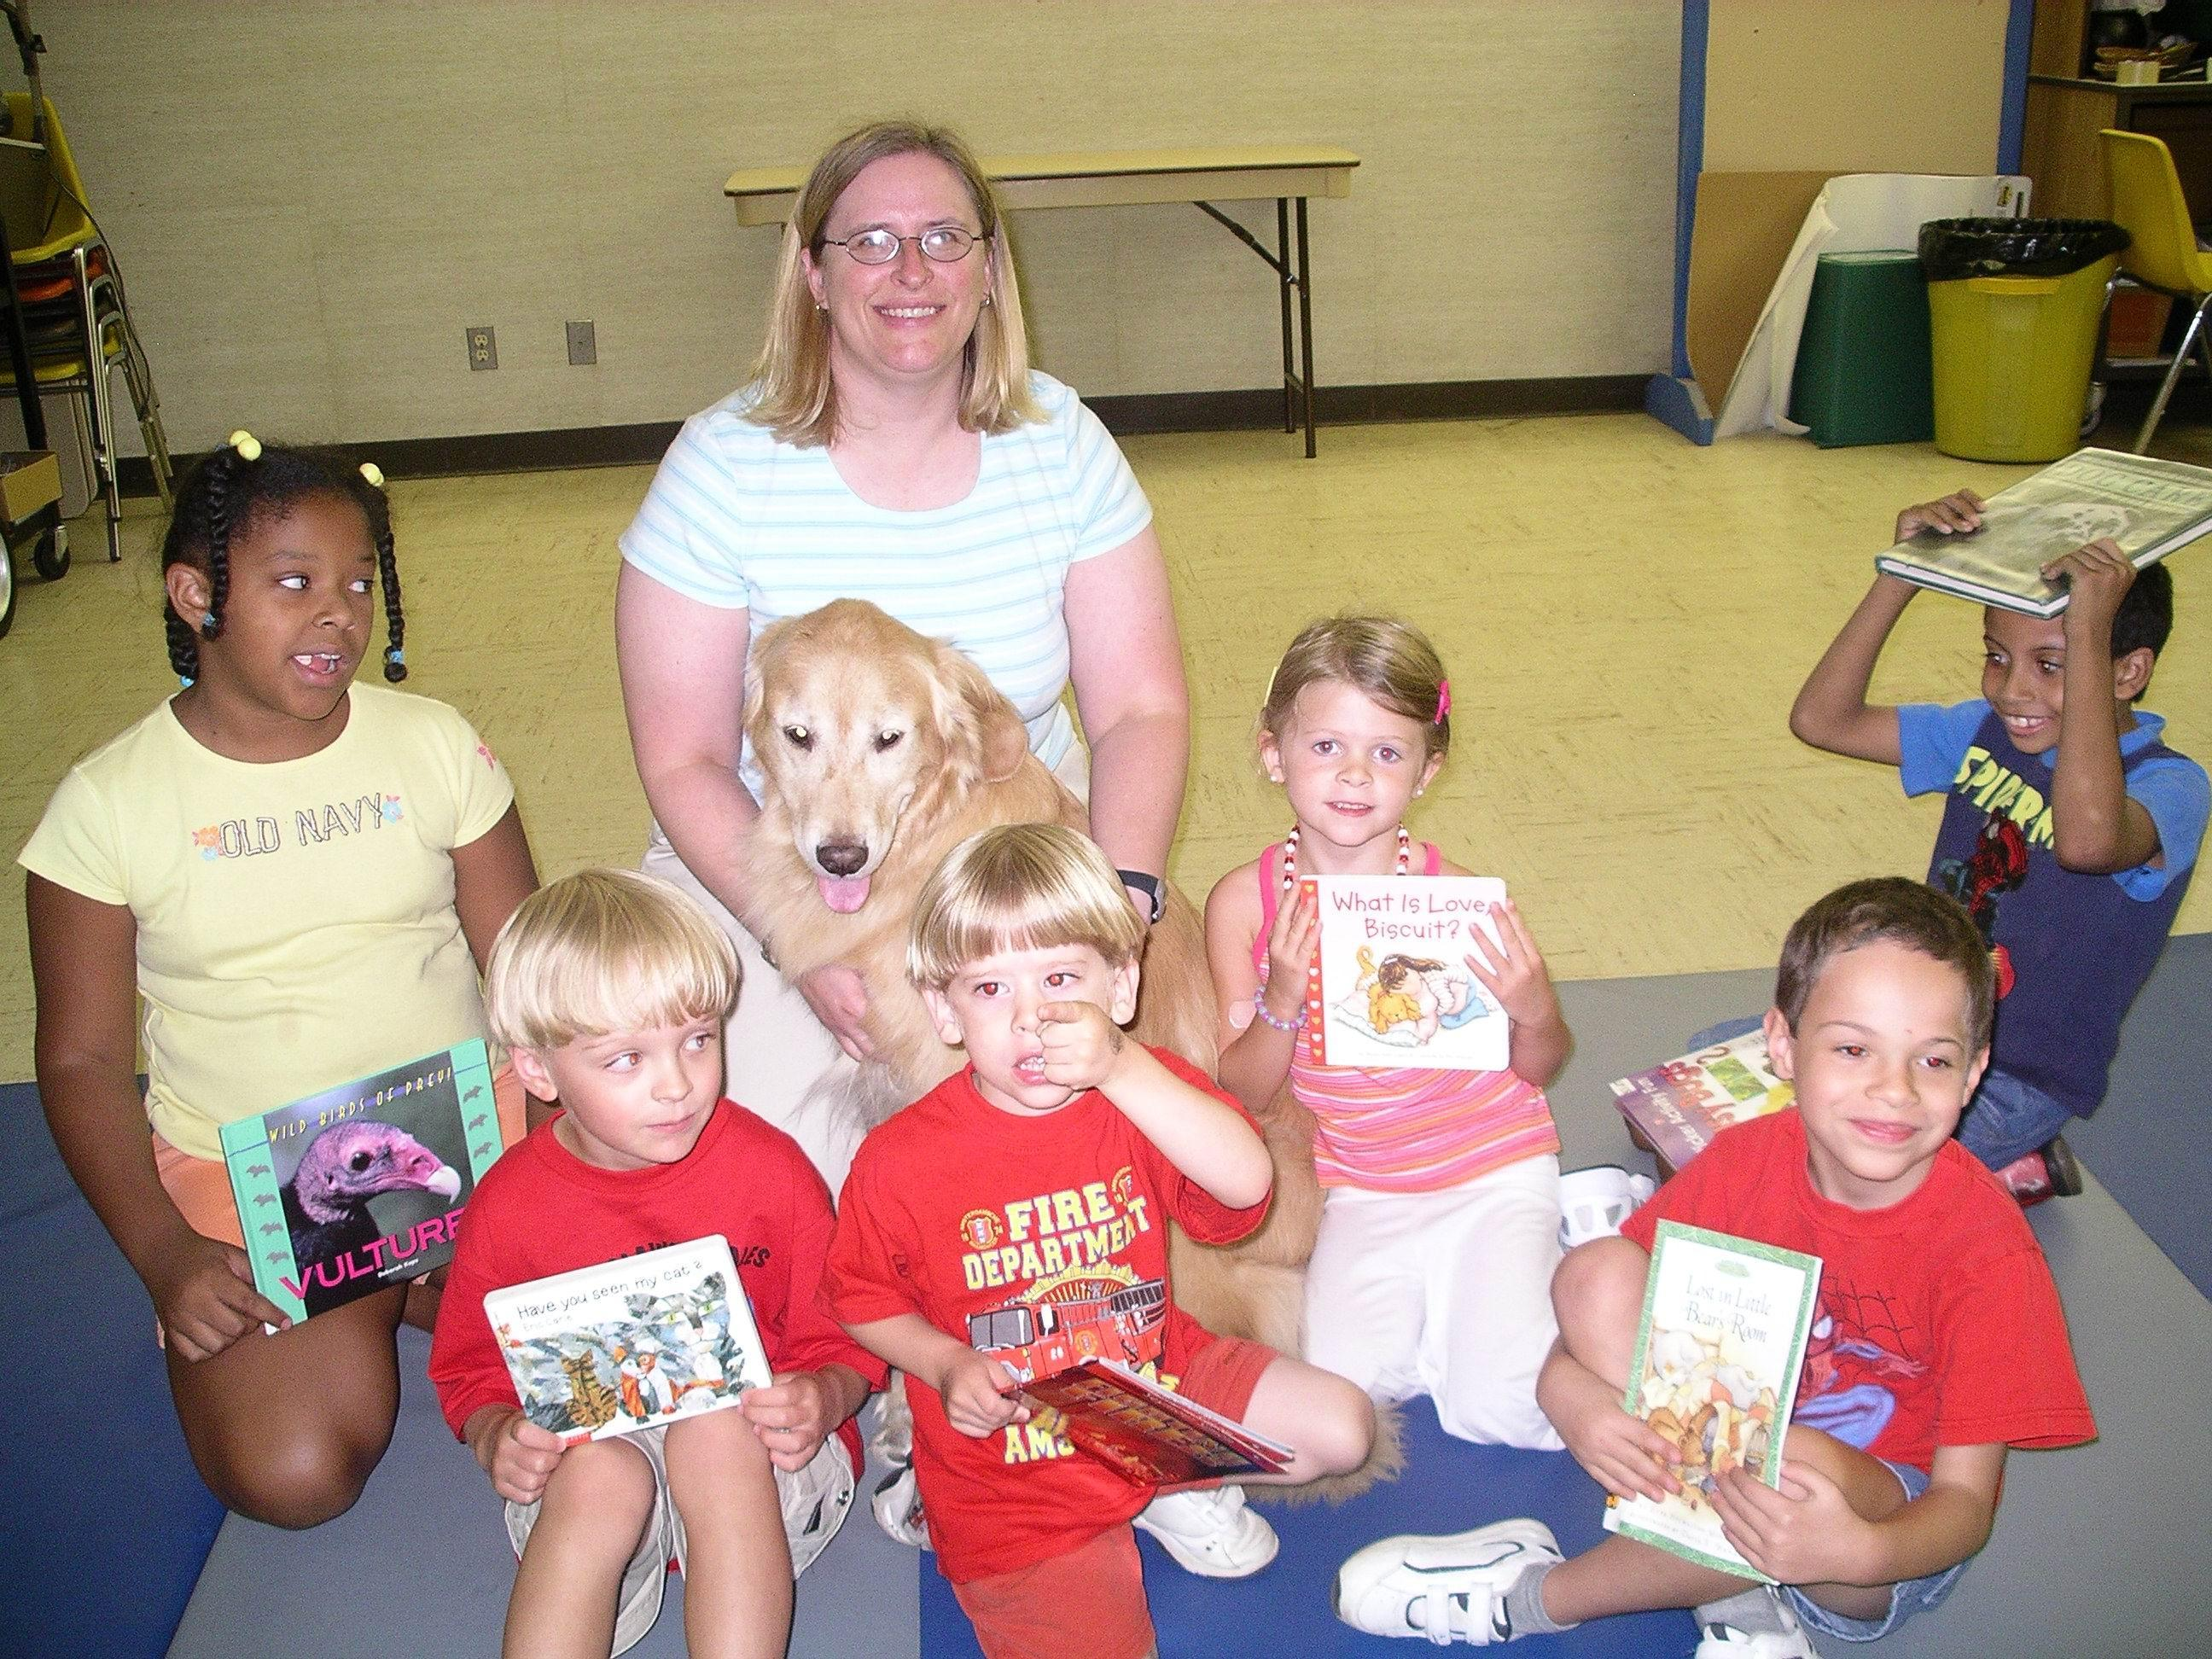
Experiments of Face Detection
Performance of face detection
Datasets
PASCAL face
1335 faces from 851 images
Some examples:
AFW
205 images with 473 labeled faces
Some examples:
Notes:
PASCAL person layout dataset
Annotated Faces in the Wild

Slide 19
Experiments of Face Detection (cont.)
Performance of face detection
Datasets
FDDB
5,171 faces in 2,845 images
Evaluate on discrete ROC curves
Provide bounding ellipse
Data-preprocessing: convert the ellipses to minimum bounding rectangles
bounding ellipse
Notes:
Face Detection Data Set and Benchmark
離散的意思是一個face一個face看

Slide 20
Experiments of Face Detection (cont.)
Evaluation of face detection runtime
Dataset
UTKFace
Large-scale face dataset and only single face in one image
23,709 facial images
https://susanqq.github.io/UTKFace/
Notes:
每張照片只有一個人臉
所以不會出現一張照片要偵測多個人臉的情況

Slide 21
Experiments of Face Detection (cont.)
Performance of face detection
Intersection over Union (IOU)
An Intersection over Union score > 0.5 is normally considered a “good” prediction. Depending on the metric, threshold usually be set to 50%, 75% or 95%.

Slide 22
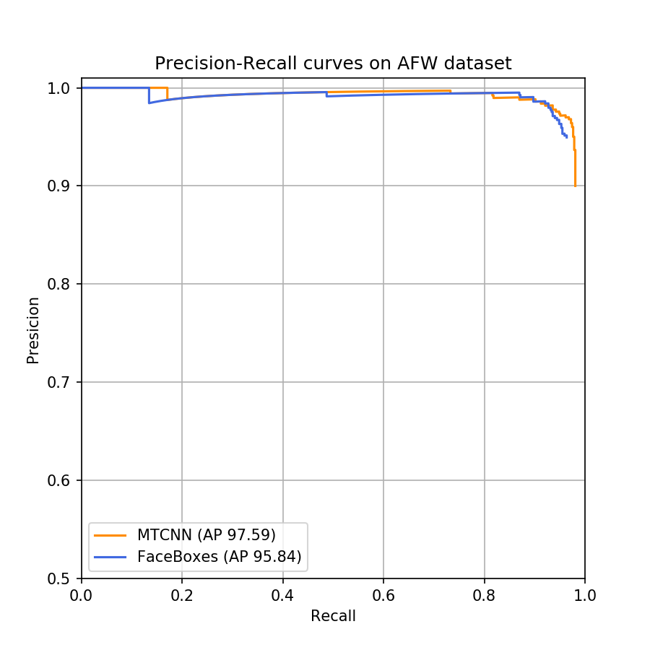
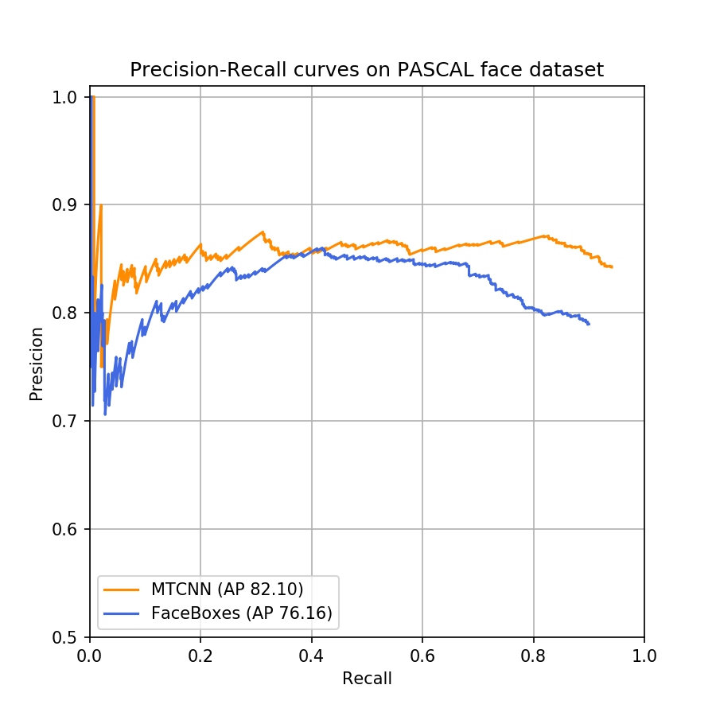
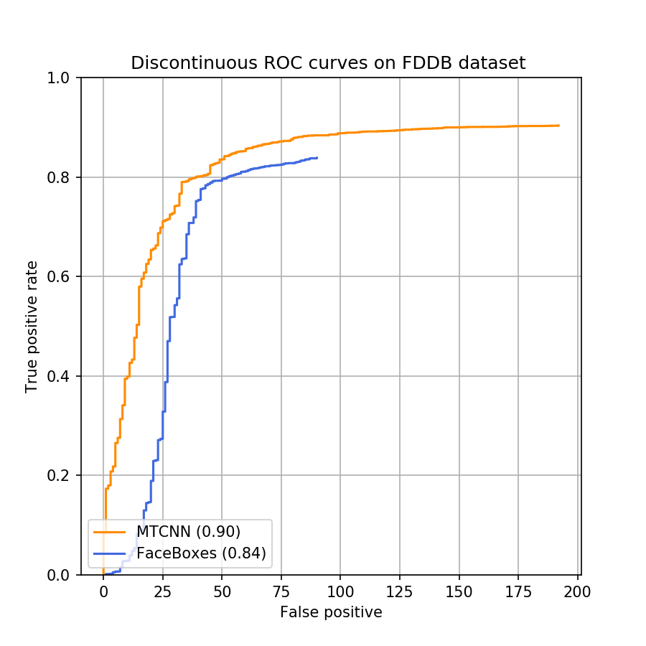
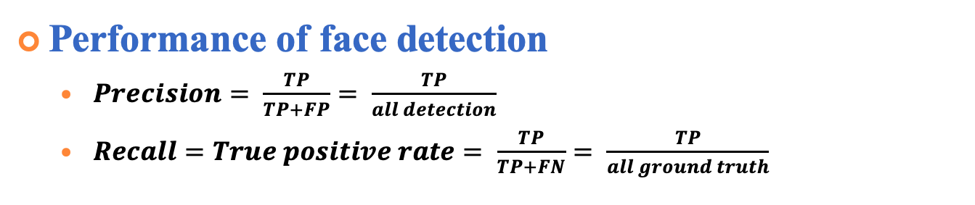
Experiments of Face Detection (cont.)
Performance of face detection
$Precision= \frac{TP}{TP+FP}= \frac{TP}{all detection}$
$Recall=True positive rate= \frac{TP}{TP+FN}= \frac{TP}{all ground truth}$
AFW dataset
PASCAL face dataset
FDDB dataset
Notes:
Average precision 就是曲線下的面積
ＦＤＤＢ他有自己的評估方式類似roc的方式，橫軸是false positive

Slide 23
Experiments of Face Detection (cont.)
Evaluation of face detection runtime
Dataset
UTKFace
Approach | mAP(%) | FPS (On GPU) | FPS (On CPU)
MTCNN | 94.4% | 8.86 | 6.25
FaceBoxes | 89.3% | 42.91 | 20.07

Slide 24
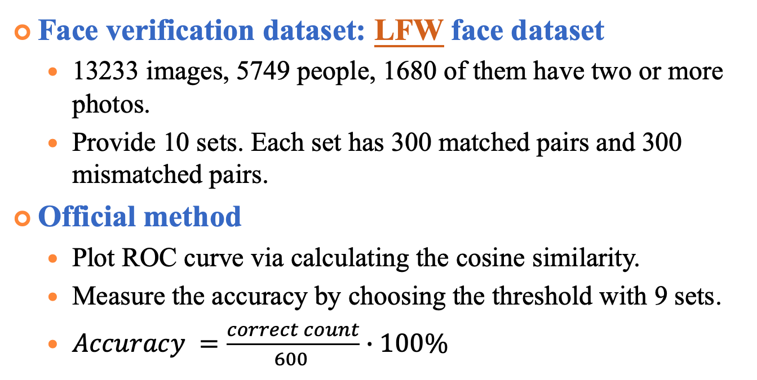
Experiments of Face Verification
Face verification dataset: LFW face dataset
13233 images, 5749 people, 1680 of them have two or more photos.
Provide 10 sets. Each set has 300 matched pairs and 300 mismatched pairs.
Official method
Plot ROC curve via calculating the cosine similarity.
Measure the accuracy by choosing the threshold with 9 sets.
$Accuracy =\frac{correct count}{600 }∙100\%$
Match pairs
Mismatch pairs
http://vis-www.cs.umass.edu/lfw/
Notes:
Labeled Faces in the Wild ver/rec
http://vis-www.cs.umass.edu/lfw/index.html

Slide 25
Experiments of Face Verification (cont.)
Performance evaluation on LFW
 | Accuracy (%) | Time (s)
VGG16 | 95.33% | 129
Resnet50 | 99.33% | 139
Notes:
有 9 fold 每個fold都有自己的fpr/tpr 曲平均可以畫出平均的roc curve
9 個Auc的標準差代表一個標準差是0.001
標準差 根據fold/acc
設定一段threshold的區間，透過10fold算各自錯幾個，選擇平均錯最少的當作threshold 接著再用此threshold當作標準算10fold各自的accuracy平均 小標題要寫ver/rec

Slide 26
Experiments of Face Verification (cont.)
Authorized user dataset
CASIA-FaceV5
2,500 color facial images of 500 subject, each has 5 images
For each user, 4 images for gallery images and 1 image for test.
All face images are 16 bit color BMP files and the image resolution is 640*480
http://biometrics.idealtest.org/dbDetailForUser.do?id=9
Notes:
http://biometrics.idealtest.org/dbDetailForUser.do?id=9

Slide 27
Experiments of Face Verification (cont.)
Intruder dataset
Helen dataset
2000 images as the intruder dataset
If there are multiple faces in the picture, select the one closest the image center as the test face.
http://www.ifp.illinois.edu/~vuongle2/helen/

Slide 28
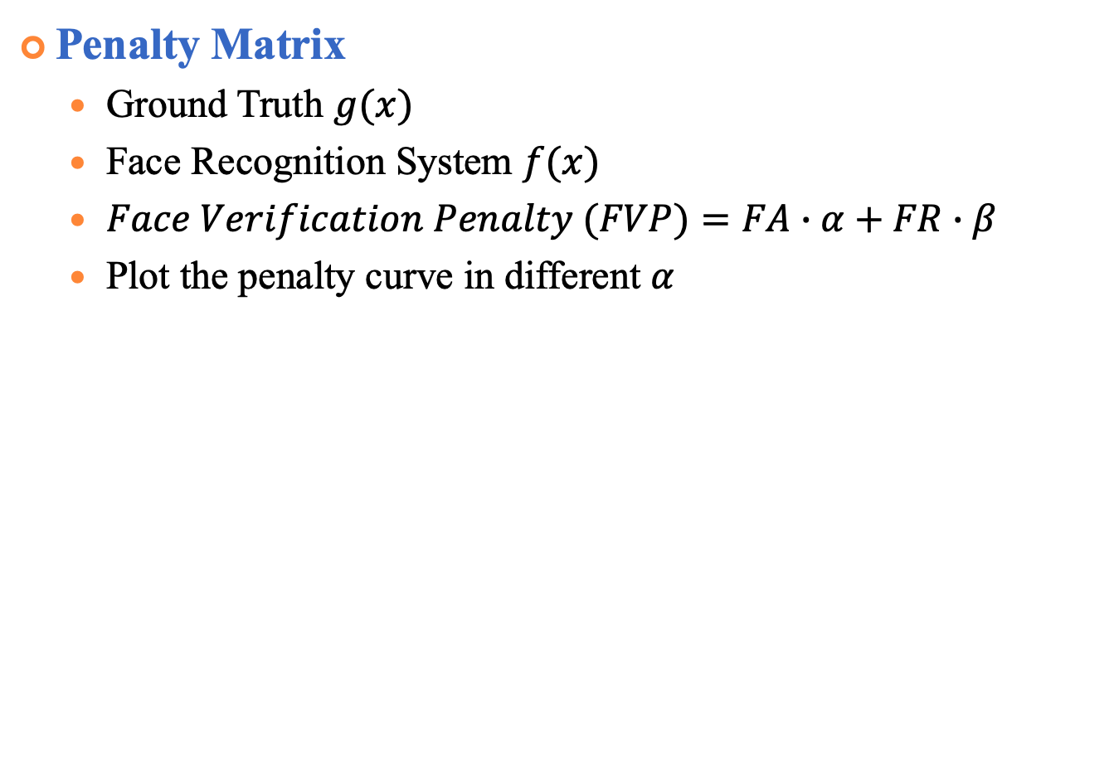
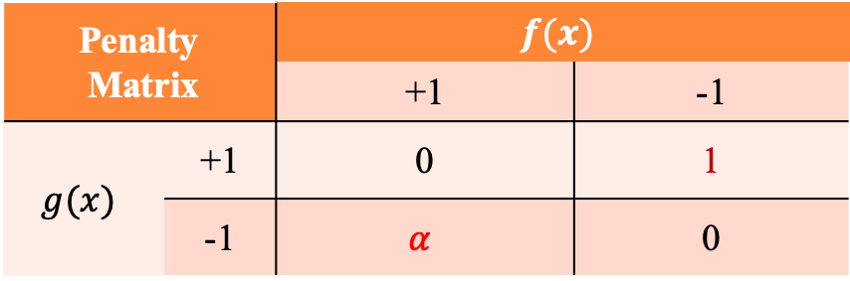
Experiments of Face Verification (cont.)
Penalty Matrix
Ground Truth $g(x)$
Face Recognition System $f(x)$
$Face Verification Penalty (FVP)=FA∙α+FR∙β$
Plot the penalty curve in different $α$
Penalty Matrix |  | $$f(x)$$
 |  | +1 | -1
$$g(x)$$ | +1 | 0 | 1
 | -1 | $$α$$ | 0
Notes:
調整false accept的懲罰值來選threshold

Slide 29
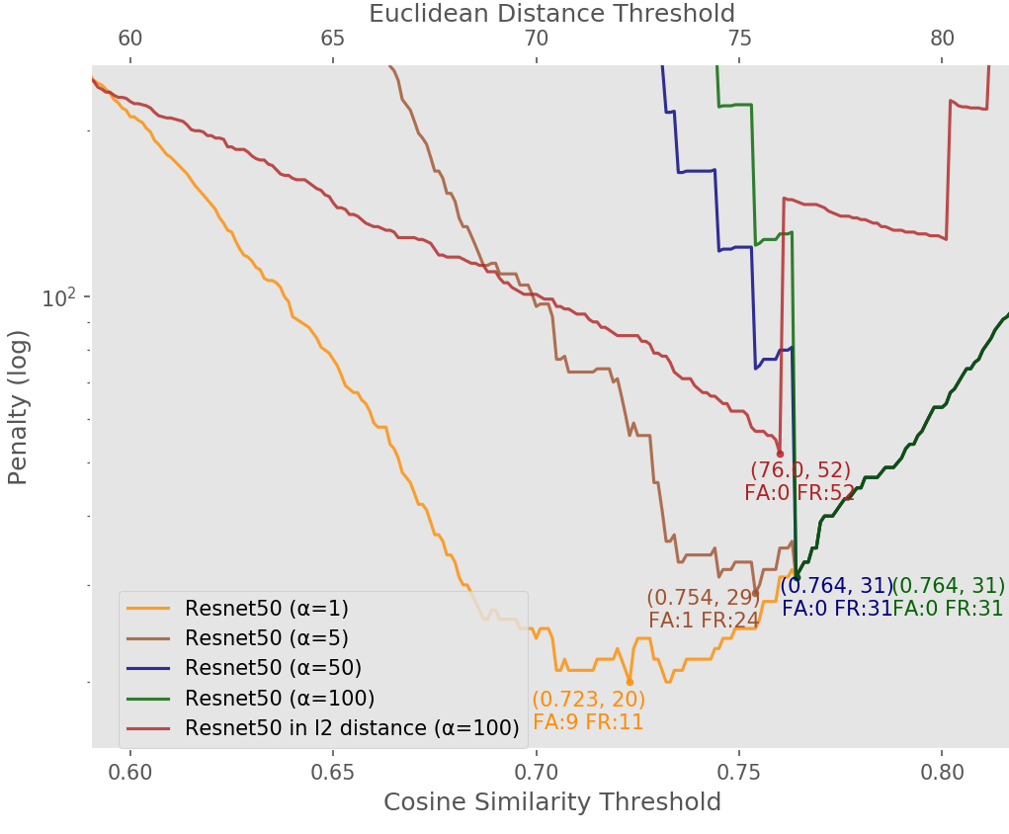
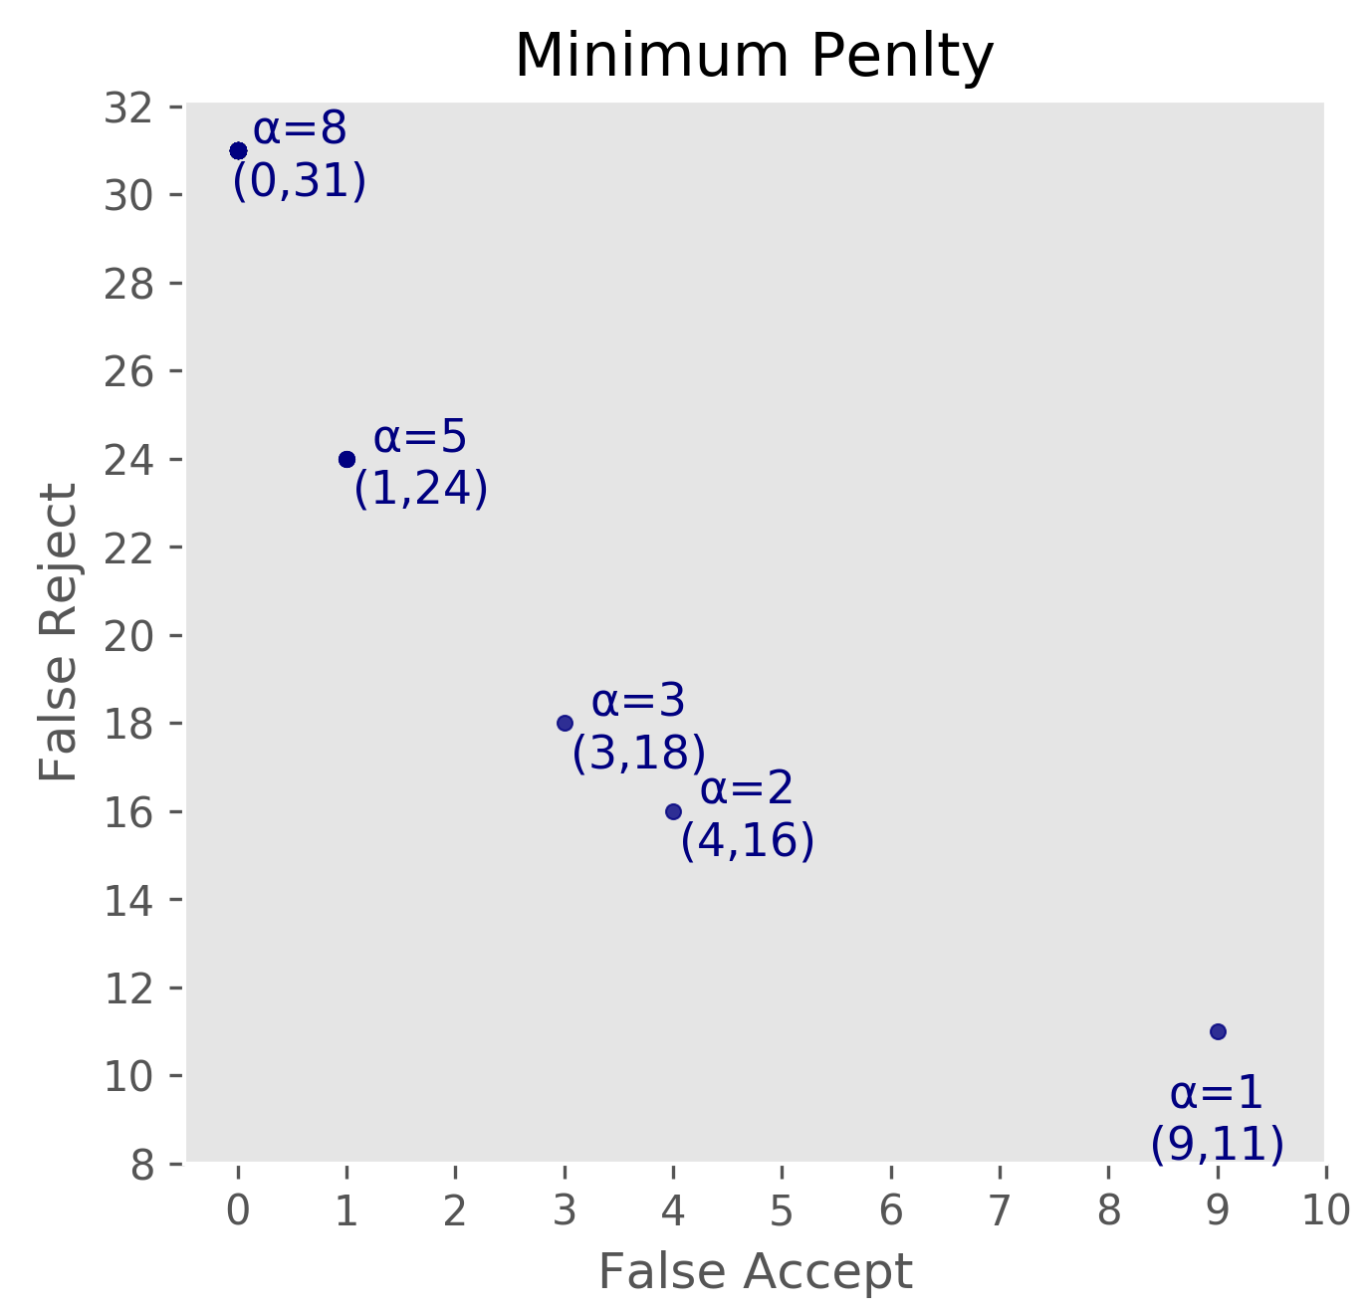
Experiments of Face Verification (cont.)
Face verification penalty curve
Notes:
先講橫坐標縱座標
隨著FA的penalty變大penalty會隨之上升
但是ＦＡ會降到0，所有的penalty都是因為false reject到
另外在同樣的penalty下用cosine similarity 的表現比Euclidean來得好

Slide 30
Experiments of Face Verification (cont.)
Compare the effect of Alignment and Average
Notes:
先看實線跟虛線，虛線都比實現來得低，代表有做align的penalty比較低
再來看藍線跟橘線，藍縣市做average，也就是把每個人在dataset的feature曲平均，表現比較好

Slide 31
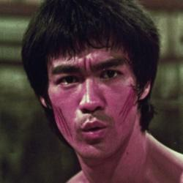
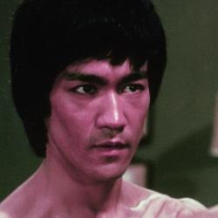
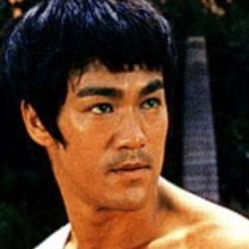
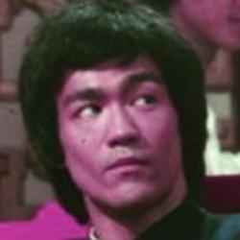
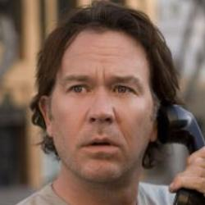

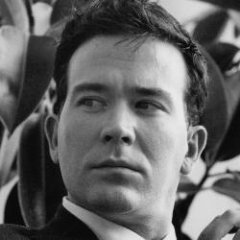
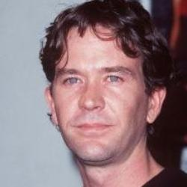
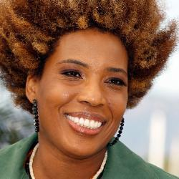
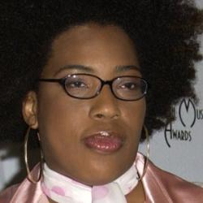


Experiments of Face Identification (1/3)
CASIA-WebFace
10,575 identities, 494,414 face images
Select 10,559 identities whose images count is more than 5
Remove 27,703 wrong images after data cleaning
Notes:
large inter-class variation dataset

Slide 32
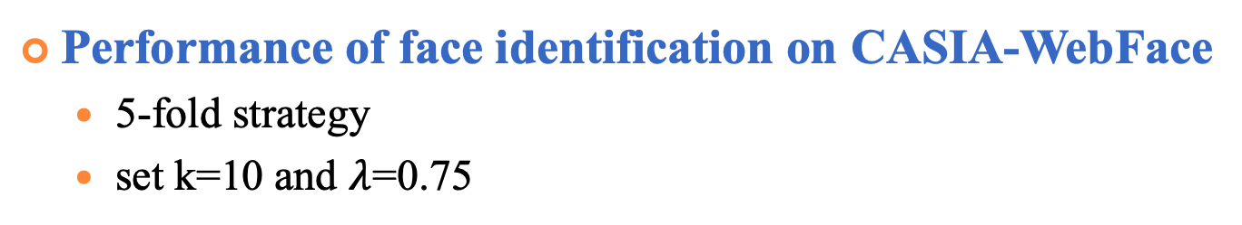
Experiments of Face Identification (1/3)
Performance of face identification on CASIA-WebFace
5-fold strategy
set k=10 and $λ$=0.75
Component | Configuration
Alignment |  |  |  | ✓ | ✓ |  | ✓
Average |  |  | ✓ |  |  | ✓ | ✓
Re-rank |  | ✓ |  |  | ✓ | ✓ | ✓
Mean Acc. (%) | 84.47 | 85.84 | 86.48 | 82.97 | 84.98 | 86.75 | 86.14
Notes:
在without average的情況下rerank可以有1%以上的進步
效果最好的是有做average以及加上我們的re-ranking
我們認為原因是因為做了average後可以得到比較robust的feature 克服光線角度或是髮型的原因

Slide 33
Experiments of Face Identification (2/3)
FG-NET
82 identities, 1,002 images, cross-age, 0 to 69 years old
Image count
ID
Notes:
這是large cross-age dataset 也就是large intra-class variation dataset 每個人幾張到幾張

Slide 34
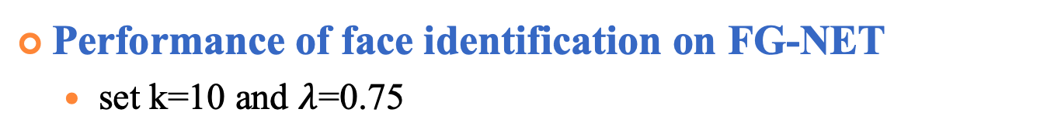
Experiments of Face Identification (2/3)
Performance of face identification on FG-NET
set k=10 and $λ$=0.75
Component | Configuration
Alignment |  |  |  | ✓ | ✓ |  | ✓
Average |  |  | ✓ |  |  | ✓ | ✓
Re-rank |  | ✓ |  |  | ✓ | ✓ | ✓
Rank-1 Acc. (%) | 86.62 | 87.22 | 83.43 | 87.32 | 87.92 | 83.63 | 84.53
Method | Rank-1 Acc. (%)
HFA (2013) | 69.0
MEFA (2015) | 76.2
CAN (2017) | 86.5
LF-CNNs (2016) | 88.1
Ours | 87.92
Notes:
在這個large intra-class variation 的dataset最好的setting反而跟前一個dataset不同
用了average反而降低,因為用了average會讓這個人的feature偏向中間年齡 在without average加上rerank的效果最好
另外我們也有與一些state of the art比較 這些都是專門為cross-age所做的方法
代表我們的feature extractor＋reranking method可以得到一個很接近的結果

Slide 35
Experiments of Face Identification (3/3)
CACD (Cross-Age Reference Coding for Age-Invariant Face Recognition and Retrieval)
contains more than 160,000 images of 2,000 celebrities with age ranging from 16 to 62
face retrieval with three different subsets, 2004-2006, 2007-2009, 2010-2012images taken in 2013 are used as query
Two measurements: mAP / Precision@1(Rank-1 accuracy)

Slide 36
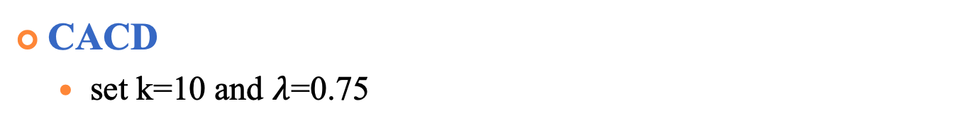
Experiments of Face Identification (3/3)
CACD
set k=10 and $λ$=0.75
Methods | Rank-1 accuracy (%)
 | 04-06 | 07-09 | 10-12
LBP (2013) | 78.0 | 80.3 | 85.5
CARC (2014) | 88.8 | 88.5 | 92.2
Baseline | 81.5 | 84.1 | 85.4
Baseline + ours | 85.7 | 86.9 | 88.2
Notes:
左圖很明顯的每個method的map都逐年上升
蠻合理的因為query是2013年的照片越接近的年份表現越好
Baseline是完全不做rerank，都有3、4％的進步
在rank-1 accuracy上我們的方法也有comparable 效果

Slide 37
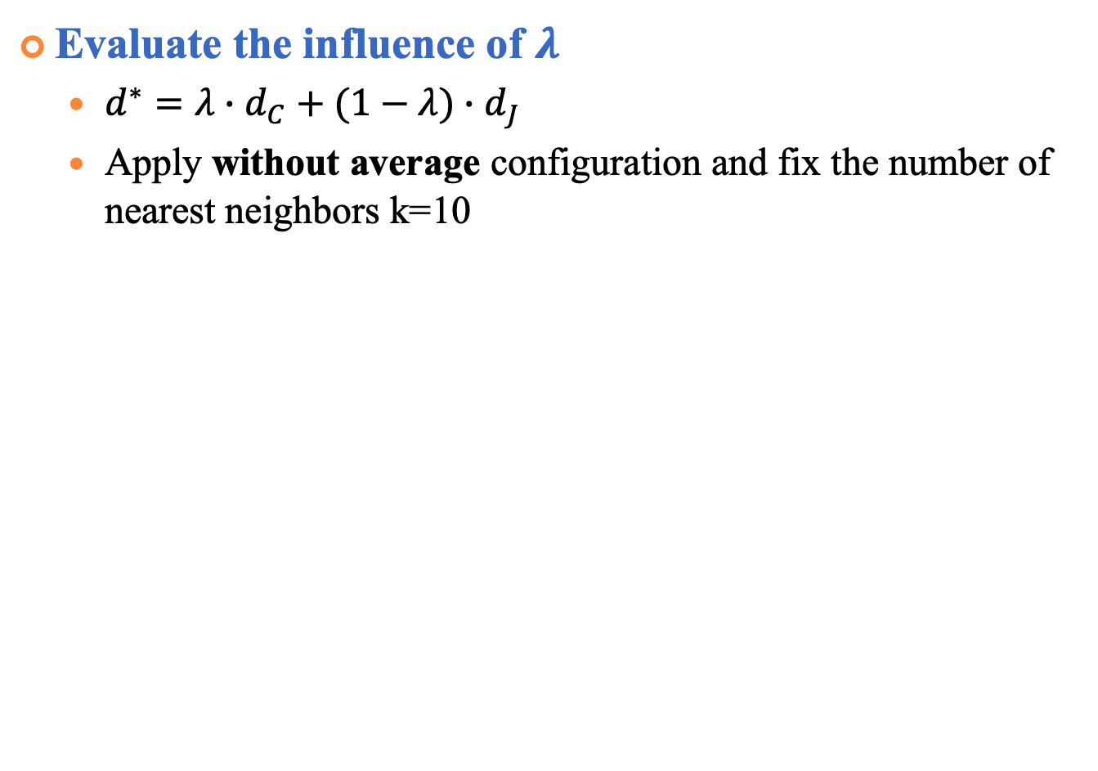
Parameter Analysis
Evaluate the influence of $λ$
$d^{∗}=λ∙d_{C}+(1−λ)∙d_{J}$
Apply without average configuration and fix the number of nearest neighbors k=10
Notes:
在$λ=1$的時候就是原本的cosine distance不做rerank
$λ=0$的時候就是只看Jaccard distance
可以看到在四個dataset中有做rerank都可以有將近1%的進步
在inter-class dataset中可以選0.8當作$λ$
Intra-class dataset 可以選0.75當作$λ$

Slide 38
Conclusions and discussions
Conclusions
A specific preprocessing is provided to obtain the best performance for face authentication.
Our proposed re-ranking method is beneficial for enhancing the performance of face identification.
Apply without average setting for intra-class variation datasets while using average strategy for inter-class variation dataset.
Future Work
Focus on improving the policy of re-ranking.
Develop more efficient models on edge devices.

Slide 39
Thank you for your attention

Slide 40
Backup

Slide 41
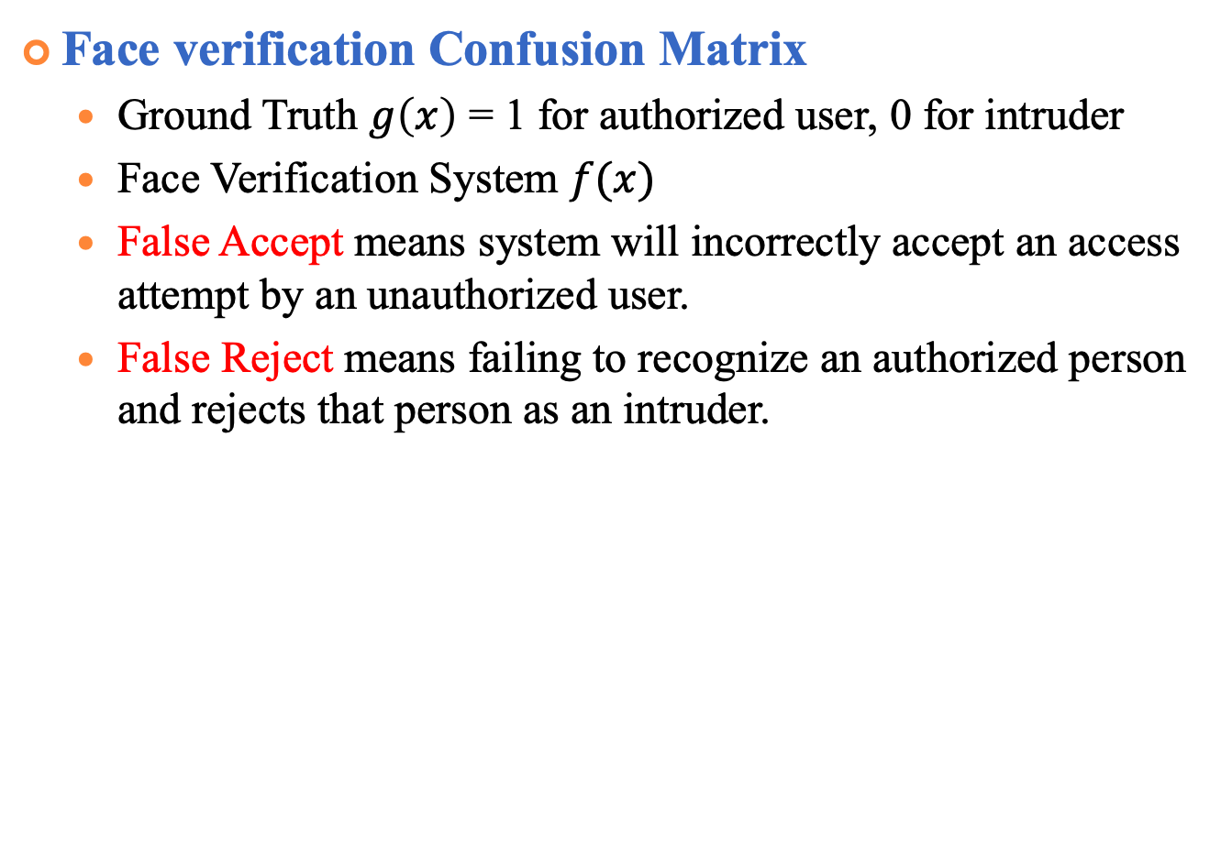
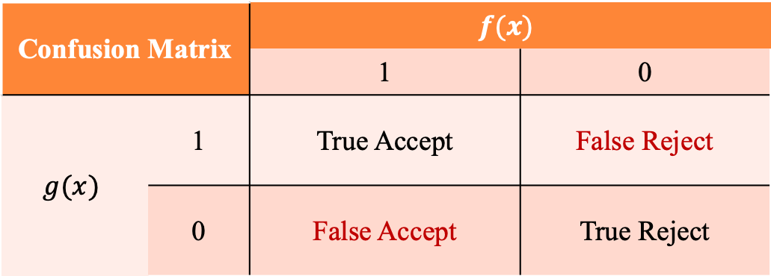
Experiments of face verification (cont.)
Face verification Confusion Matrix
Ground Truth $g\left(x\right)$ = 1 for authorized user, 0 for intruder
Face Verification System $f(x)$
False Accept means system will incorrectly accept an access attempt by an unauthorized user.
False Reject means failing to recognize an authorized person and rejects that person as an intruder.
Confusion Matrix |  | $$f(x)$$
 |  | 1 | 0
$$g(x)$$ | 1 | True Accept | False Reject
 | 0 | False Accept | True Reject
Notes:
http://www.mecs-press.org/ijigsp/ijigsp-v6-n2/IJIGSP-V6-N2-6.pdf 備用投影片

Slide 42
Experiments of Face Identification
Performance of face recognition on CASIA-FaceV5
No. | Alignment | Mean | Re-ranking | HNSW Time (s) | Ori. Time (s) | 100%-EER
1 | × | × | × | 27 | 55 | 98.8 (494/500)
2 | × | × | ✓ | 65 | 105 | 99.0 (495/500)
3 | × | ✓ | × | 22 | 32 | 99.6 (498/500)
4 | × | ✓ | ✓ | 48 | 73 | 99.6 (498/500)
5 | ✓ | × | × | 43 | 76 | 98.6 (493/500)
6 | ✓ | × | ✓ | 87 | 145 | 99.2 (496/500)
7 | ✓ | ✓ | × | 50 | 71 | 99.8 (499/500)
8 | ✓ | ✓ | ✓ | 92 | 151 | 99.8 (499/500)
Notes:
1 2比較是指有取mean表現比較好
2 3是指只有在test有alignment情況下反而不好
3 4是在train/ test都alignment情況下效果最好
4 5是在都有alignment情況下取mean的效果比較好
5 6代表rerank可以提升效果
同樣的 7 8也是rerank可以提升效果 加上取mean的照片

Slide 43
Inception Module
Notes:
Inception Module中包含了3种不同尺寸的卷积和1个最大池化，增加了网络对不同尺度的适应性
用1x1的conv用意是降低深度類似bottleneck

Slide 44
NMS (Non-maximum suppression)
Notes:
幾個框都檢測到了人臉，但是我不需要這麼多的框，我需要找到一個最能表達人臉的框
我們的目標是一個人只保留一個最優的框
將所有框的得分排序，選中最高分及其對應的框

Slide 45
NMS (Non-maximum suppression)
Notes:
遍歷其餘的框，如果和當前最高分框的重疊面積(IOU)大於一定閾值，我們就將框刪除。

Slide 46
NMS (Non-maximum suppression)
Notes:
從未處理的框中繼續選一個得分最高的，重複上述過程。

Slide 47
NMS (Non-maximum suppression)

Slide 48

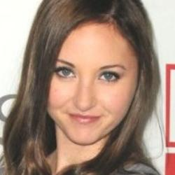
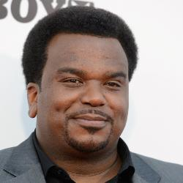
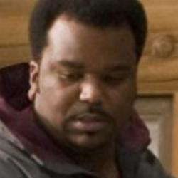










Error images (with average)
#1347153
#0289200
#0732497
0.239156
#3094377
0.334627
#0732497
0.327346
#0289200
0.338473

Slide 49
Experiments of Face Identification (cont.)
Error images of (w/ mean, both alignment)
Closest (#152)
Similarity: 0.698157
2nd Closest (#331)
Similarity: 0.673734
3rd Closest (#463)
Similarity: 0.669009
(#003_4)
4th Closest (#157)
Similarity: 0.667395
5th Closest GT)
Similarity: 0.659691
Notes:
Preprocessing ：subtract channel-wise mean mean channel values of all pictures in dataset.
[91.4953, 103.8827, 131.0912] (in BGR order).

Slide 50
Experiments of Face Identification (cont.)
Error images of (w/o mean)
(#118_2)
(#419_0)
(#115_3)
(#118_1)
(#320_4)
(#118_4)
(#262_ 0)
(#182_1)
(#295_2)
(#262_2)
(#244_1)
(#262_1)
(#188_3)
(#187_0)
(#188_2)
(#482_0)
(#084_2)
(#471_4)
Notes:
Preprocessing ：subtract channel-wise mean mean channel values of all pictures in dataset.
[91.4953, 103.8827, 131.0912] (in BGR order).

Slide 51
Experiments of Face Identification (cont.)
Error images (w/o mean, alignment)
(#118_2)
(#419_0)
(#115_3)
(#118_1)
(#118_4)
(#118_3)
(#143_2)
(#258_1)
(#143_4)
(#258_0)
(#436_1)
(#143_0)
(#188_3)
(#187_0)
(#188_2)
(#482_0)
(#188_4)
(#471_4)
Notes:
多加一個投票

Slide 52
Experiments of Face Identification (cont.)
Error images (w/o mean, test align, re-rank)
(#457_2)
(#312_3)
(#280_2)
(#409_0)
(#457_1)
(#409_2)
(#143_2)
(#258_1)
(#143_4)
(#258_0)
(#436_1)
(#143_0)
(#188_3)
(#187_0)
(#188_2)
(#482_0)
(#188_4)
(#471_4)
Notes:
多家simility 眼鏡可以加在future

Slide 53
Method of Re-ranking
Re-ranking policy (Learning to rank)
Cosine distance | L2 distance | Flipped cosine distance | Flipped L2 distance
Label
1
1
1
0
0
Probe
#379_2
0.267723
#152_4
0.267590
Flipped
Probe

Slide 54
Method of Re-ranking
Re-ranking policy (Learning to rank)
Calculate Features
Probe
L2R model
New rank
Face Feature Extractor
Cosine
distance rank

Slide 55
Experiments of Face Identification
Performance of face identification on CASIA-WebFace
Component | Configuration
Alignment |  |  |  | ✓ | ✓ |  | ✓
Average |  |  | ✓ |  |  | ✓ | ✓
Re-rank |  | ✓ |  |  | ✓ | ✓ | ✓
Our proposed Mean Acc. (%) | 84.47 | 85.84 | 86.48 | 82.97 | 84.98 | 86.75 | 86.14
Learning to rank |  | 83.89 |  |  | 82.97

